Slide 1
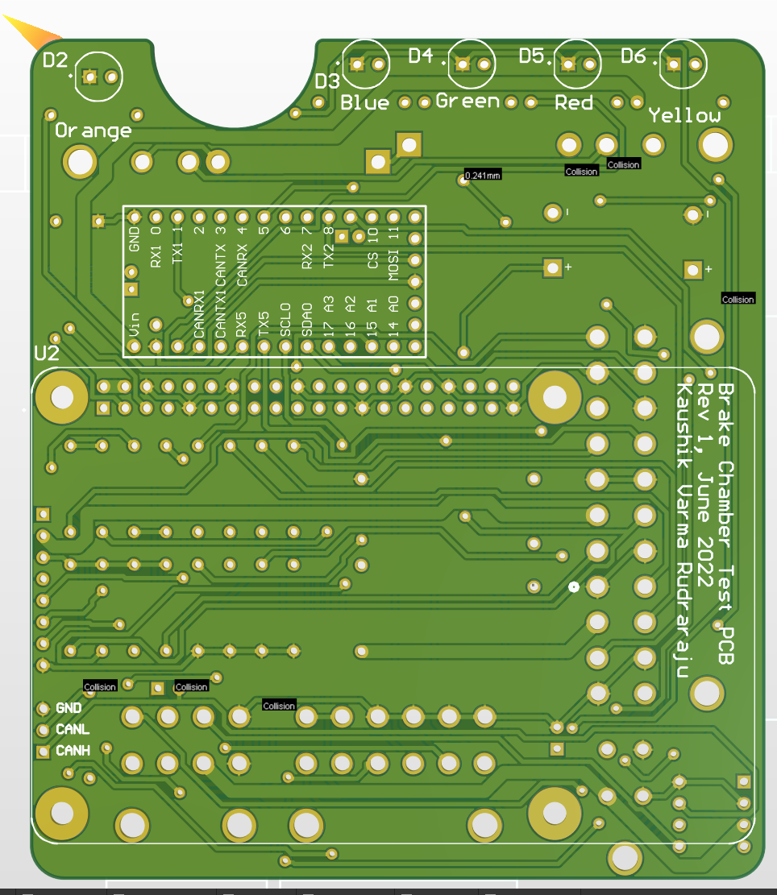
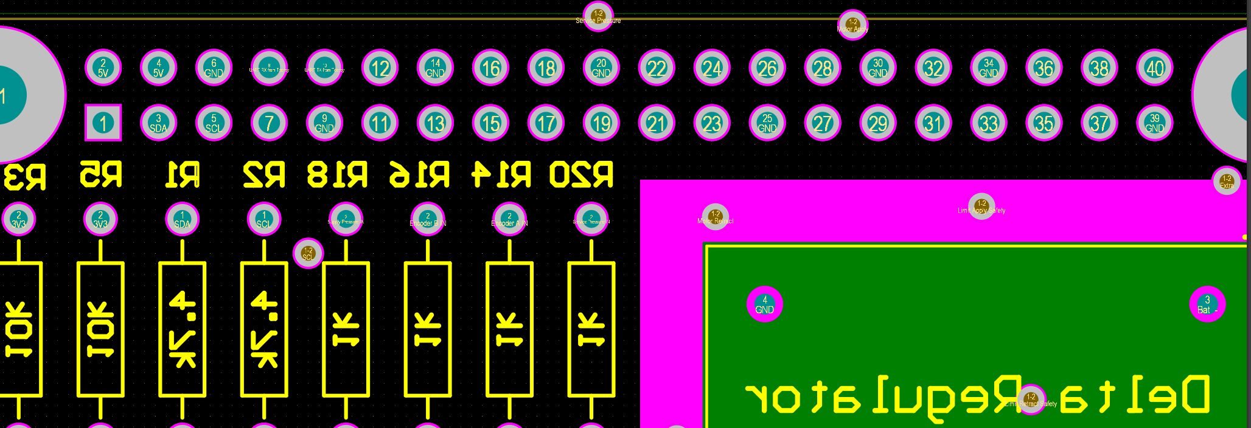
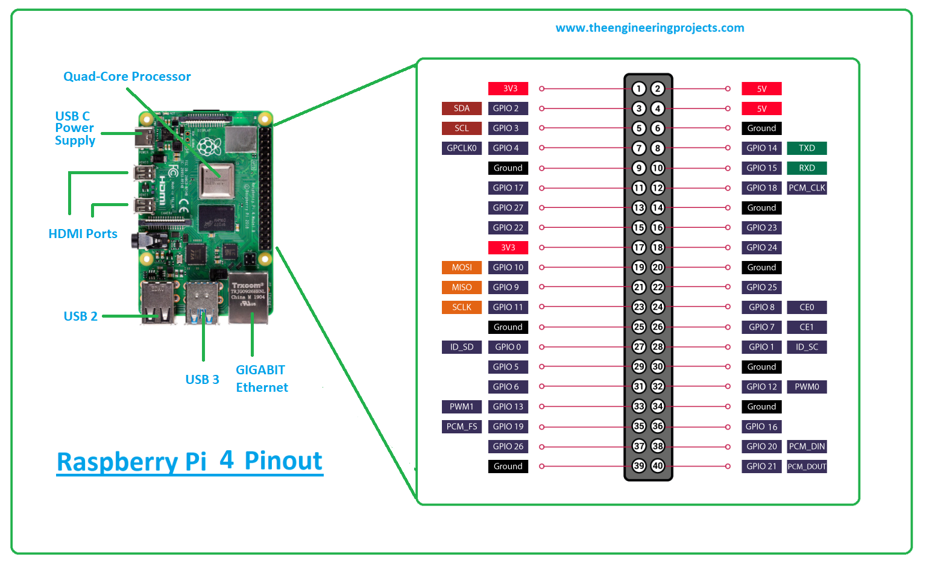
Note:
The TXD line will have to tie to the Raspberry Pi header instead of the PCB header. All other connections can be made with wire on the PCB.
= Remove Pin from PCB
GND
RXD
TXD
5V
39 29 19 9 1
SDA
SCL

